Slide 1
Sports Medicine/ Athletic Training
AthLetic Medicine i
Chapters 1-3

Slide 2
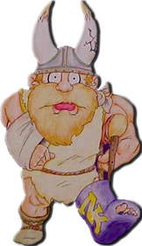

Slide 3
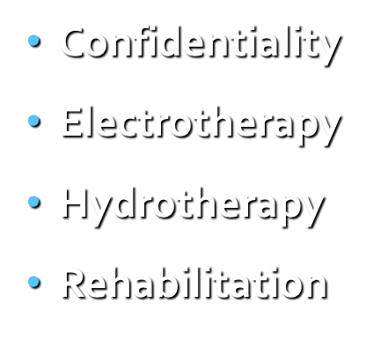
Vocabulary
Sports Medicine
Athletic Training
NATA
Certified Athletic Trainer

Slide 4
History of Sports Medicine/Athletic Training

Slide 5
Sports Medicine/Athletic Training began in Ancient Greece.
Two Doctors who began Sports Medicine in ancient times were:
Galen
Herodicus

Slide 6
Galen
Greatest name in Roman Medicine
Served as the first physician for gladiator contests

Slide 7
Herodicus
Roman Physician for the first Olympic Games
The first known Sports Medicine Physician as we know it today.

Slide 8
The fall of the Roman Empire brought about a lack of interest in sports and brought down the profession of Athletic Training because there was no one to take of.
The lack of interest in sports stayed that way until the Renaissance period.
The Renaissance period brought back the interest in sports.
Why?????
The Reason:
The focus of the Renaissance period was put on the ideal body.

Slide 9
During this time, athletic trainers were known as people who helped the athletes reach their top performance.
Stayed this way until 1917

Slide 10
1917
In 1917, Dr. SE Bilick wrote the first major text on athletic training and care of athletic injuries.
Text book was called the The Trainer’s Bible
Then came the Evolution of the Contemporary Athletic Trainer

Slide 11
What is Sports Medicine?
Sports Medicine (Athletic Medicine) is a multidisciplinary field, including physiology, biomechanics, sports psychology, physical therapy, and other pathological phenomenas.
American College of Sports Medicine
In general, Sports Medicine encompasses many different fields of study related to sports, exercises, and athletics.

Slide 12
Athletic Training
What is Athletic Training?
Athletic Training is the prevention, evaluation, treatment, rehabilitation, counseling, and education of all athletic injuries.
The Certified Athletic Trainer deals with the athlete throughout the period of rehabilitation.
From the time the initial injury occurs until the athlete returns to play.
An Athletic Trainer must be competent in all areas of the Sports Medicine Umbrella if they are to be effective in preventing and treating injuries to the athlete.

Slide 13
Here are a few professions that Fall under the Sports Medicine Umbrella

Slide 14
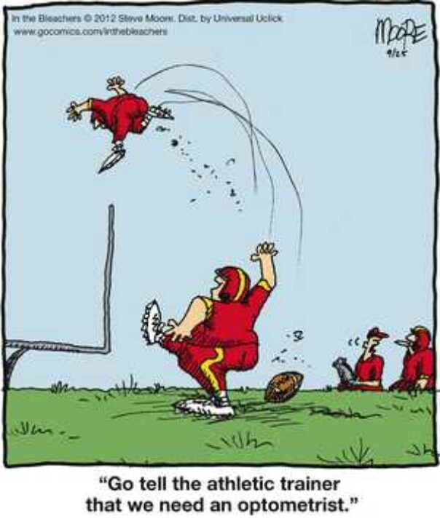

Slide 15
Sports Medicine Team
The team of professionals that are directly involved with the health care of the athlete.
Team Physician
Certified Athletic Trainer
Coach
Dentist
Psychologist
Physical Therapist
School Nurse

Slide 16
Physician
Coach
Athlete
Athletic Trainer

Slide 17
Roles of the Team Physician
ALL Certified Athletic Trainers must work under the supervision of a Physician
Roles and Responsibilities
Supervises and advises the Athletic Trainer
Screens the Physical Exams
Responsible for Diagnosing injuries
Aware of Rehab Programs
Be available if needed by the athletic trainer
By phone or in person

Slide 18
Roles of the Coach
Directly responsible for preventing injuries
Conditioning programs
Equipment is of highest standard
Teaching the proper techniques
Communicate with the athletic trainer.

Slide 19
Goals/Domains of Athletic Training

Slide 20
These are to define the job of the Certified Athletic Trainer.
Prevention of Athletic Injuries
Recognition, Evaluation, and Immediate care of athletic injuries
Rehabilitation and Reconditioning of athletic injuries.
Health Care administration
Professional Development and responsibility
Counseling and Education of Athletic Injuries

Slide 21
Prevention of Athletic Injuries
Tasks involved:
Develop Training and Conditioning Programs
Ensure a safe Playing Environment
Proper fitting of Equipment
Educating parents, coaches, and athletes about risk of playing sports
Explaining the importance of Nutrition
Using Medications appropriately

Slide 22
Recognition, Evaluation, and Immediate Care of Athletic Injuries
Tasks involved:
Conducting physical examinations
Understanding the pathology of injury and illness
Immediate care, first aid for athletic injuries
Referral to appropriate medical personnel– if necessary.
Incorporating therapeutic modalities

Slide 23
Rehabilitation and Reconditioning of Athletic Injuries
Tasks involved:
Designing rehabilitation programs
Supervise rehabilitation programs
Incorporating therapeutic modalities

Slide 24
Health Care Administration
Tasks involved:
Record Keeping
Ordering equipment and supplies
Supervision of Student Athletic Trainers and Assistants
Establishing policies of operation

Slide 25
Professional Development and Responsibility
Tasks involved:
Promoting the profession
Athletic Trainer as a researcher
Continuing Education
Every Athletic Trainer needs 75 hours of continuing classes every 3 years.

Slide 26
Counseling and Education of Athletes
Tasks involved:
Educate athletes and parents about injuries and prevention
Offering psychosocial intervention
Athletic Trainer as an educator
Athletic Trainer as a counselor
Athletic Trainer as a researcher

Slide 27
How does a person become a Certified Athletic Trainer?
Students must successfully complete an entry-level athletic training program accredited by CAATE
~ Commission on Accreditation of Athletic Training Education
Proof of graduation with a Bachelors or Masters degree from an accredited college/university.

Slide 28
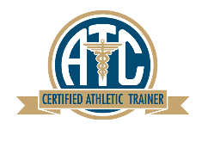
Proof of current certification in Emergency Cardiac Care (ECC)
Endorsement of application by a Certified Athletic Trainer.
Pass the certification exam (3-4Hour Exam)
Written Test– Tested over actual situations– 800 Points
Once a person passes the certification exam, then they are a Nationally Certified Athletic Trainer and use the designation of “ATC” after their name.

Slide 29
Coursework
Basic & Applied Sciences:
Human Anatomy
Human Physiology
Chemistry
Biology
Physics
Statistics & Research
Statistics
Rehabilitation
Exercise Physiology
Kinesiology/ Biomechanics
Professional Courses
Risk Management and injury/illness prevention
Pathology of injury/illness
Orthopedic Clinical Examination & Diagnosis
Medical Conditions & Disabilities
Acute Care of Injuries & Illnesses
Therapeutic Modalities
Conditioning, Rehabilitative Exercise & Pharmacology
Psychosocial Intervention & Referral
Nutritional Aspects of Injuries & Illnesses
Health Care Administration

Slide 30
The Association responsible for Certifying Athletic Trainers is the:
BOC– National Athletic Trainers Association Board of Certification.
Certified Athletic Trainers must earn 50 hours of continued education every 2 years to maintain their certification status.

Slide 31
NATA
In 1950, several college and university athletic trainers formed the NATA
NATA– National Athletic Trainers’ Association
Purpose of the NATA
To establish professional standards and a code of ethics for athletic trainers
Allow areas for Professional advancement

Slide 32
NATA
Athletic Trainers are governed by the NATA
National Athletic Trainer’s Association
The NATA is comprised of 10 Districts in the Nation
What District is Washington State in?
We are in District 10, along with Idaho, Oregon, Montana, Alaska, and British Columbia

Slide 33
Employment Settings for the Certified Athletic Trainer (Where can they work?)
High School– Salary range $10,000- $60,000
School Districts– Salary $10,000- $60,000
College/Univ.– Salary $30,000-$175,000
Professional Sports– Salary $15,000-$225,000
Clinics– Salary range $10,000- $50,000
Industry– Salary Range Varies

Slide 34
Personal Qualities of a Successful Athletic Trainer
Confidentiality
Stamina
Sense of Humor
Ability to Adapt
Empathy
Confident
Personable
Ability to Communicate
Intellectual Curiosity
Ethical Practice
Trustworthy
Hardworking
Intelligent
Loyal

