Slide 1
CPR/First Aid
By American Safety and Health Institute
CPR/first Aid Cards Are Good for Two Years

Slide 2
Vocabulary
CPR
AED
EMS
Good Samaritan Law
OSHA
Paralysis
ABC’s
Initial assessment
Physical assessment
Pathogen
OSHA
PPE
Incision
Laceration
Abrasion
Puncture
Avulsion
Sprain
Strain
Dislocation
Subluxation
Open fracture
Closed fracture
Crepitus

Slide 3
Bloodborne Pathogens

Slide 4
Bloodborne Pathogens
Objectives:
Describe how infection occurs
Identify how bloodborne pathogens are spread
Recognize the importance of personal protective equipment
Identify biohazard signs and labels
Describe emergency procedures for exposure incidents involving potentially infectious materials

Slide 5
Scenario
A woman has cut her hand and arm with a knife while opening a box in the mailroom. As the first trained person on the scene, you find the woman bleeding severely from her hand and arm. Blood is spurting from the wounds.
How would you respond to this situation and what should you be concerned about?

Slide 6
OSHA
OSHA
Occupational Safety and Health Administration
In 1991 issued the bloodborne pathogens standard
Designed to protect employees by reducing or removing the hazards of bloodborne pathogens from the workplace
This regulation applies to all persons who have occupational exposure to blood of other potentially infectious materials

Slide 7
OSHA
Occupational exposure means reasonably anticipated contact with blood or other potentially infectious materials that may result from the performance of the employee’s job duties
Provide safeguards
Proper work practices
Use of personal protective equipment (PPE)
Training
Safer medical devices along with training are the most effective means of reducing injury rates

Slide 8
How Infections Occur
A pathogen is a disease-producing organism that enters the body.
Basically, a germ
If a germ enters the body, your immune system starts to fight the disease
Most infectious diseases are caused by one of several types of pathogens.
The most common are bacteria and viruses
Bloodborne pathogens are bacteria and viruses present in blood and other body fluids that can cause disease in humans

Slide 9
Hepatitis B
A liver infection caused by the hepatitis B virus, which may be severe or even fatal
Symptoms include flu-like signals:
Fatigue
Abdominal pain
Loss of appetite
Nausea
Vomiting
Joint pain
Later stages include jaundice

Slide 10
Hepatitis B
Medications can treat chronic infection
They only work for some people
Prevention is key
Vaccination

Slide 11
HIV
Human immunodeficiency Virus
A virus that attacks white blood cells, destroys the body’s ability to fight infections and causes AIDS
Acquired immunodeficiency syndrome
An infected person may not feel or look sick
Only a blood test can detect the HIV antibody
When they start to show signs he or she may be diagnosed with AIDS
AIDS is the end result of HIV infection

Slide 12
A liver disease caused by the Hepatitis C virus.
It is the most common chronic bloodborne infection in the US
Symptoms include:
Fatigue
Abdominal pain
Loss of appetite
Nausea
Vomiting
Jaundice
Hepatitis C

Slide 13
No vaccination
No treatment after exposure that will prevent infection
Hepatitis C

Slide 14
HIV
Late-stage symptoms may include:
Fever
Fatigue
Diarrhea
Skin rashes
Night sweats
Loss of appetite
Swollen lymph glands
Significant weight loss
Victims often die from a life-threatening infections

Slide 15
Transmission
For disease to spread, all four of the following conditions must be met:
A pathogen is present
There is enough of the pathogen to cause disease
The pathogen passes through the correct entry site
A person is susceptible to the pathogen

Slide 16
Transmission
Direct Contact- When infected blood or body fluids from one person enter another person’s body at a correct entry site
Blood splashing into the eye
Indirect Contact- when a person touches an object that contains the blood or body fluids or an infected person and it enters the body
Picking up blood soaked bandages
What are some other direct and indirect ways for a pathogen to enter the body?

Slide 17
Exposure Control Plan (ECP)
OSHA Bloodborne Pathogens standard requires employers to develop a plan
A written document
How will the standard be met
Which employees are covered to protect employees and minimize risk of infection
The purpose to have an established system to help prevent employees from infection

Slide 18
Precaution & Prevention
Personal Hygeine
Personal protective equipment (PPE)
Protects a person with direct contact
Engineering and work practice controls
Engineering- things you use to reduce infection. sharps container
Work- things you do to reduce infection. Hand washing.
Equipment cleaning and disinfecting

Slide 19
Cardiopulmonary Resuscitation

Slide 20
Universal Precautions
Treat and handle all blood and bodily substances as if they are infectious
If it’s icky, sticky, and gooey and it’s not yours- treat it as if it’s infectious
Personal protective equipment (PPE)
Protects a person with direct contact
What are types of PPE?

Slide 21
Using Barriers
Putting on gloves:
Inspect gloves for damage
Removing of gloves
Remove carefully so not to splash/spray material.
Grab outside wrist of one glove with the other hand
Pull off glove and turn inside out
Put inverted glove on the other hand and slide finger under the glove and pull off. Do not snap the glove.
Face shields. Ventilation masks and shields

Slide 22
Priorities
YOUR PERSONAL SAFETY IS ALWAYS #1
Making the decision to help
Scene safety
Resources
PPE
Unconscious/Conscious
Chain of survival
Evaluations
Resources

Slide 23
Chain of Survival
Differences between an adult and child/infant?
Why?
Personal protective equipment (PPE)
Protects a person with direct contact
What are types of PPE?
What to do if you don’t have PPE

Slide 24
Initial Evaluation
Designed to rule out/treat life threatening injuries
Scenarios
Unconscious and not breathing
Unconscious but breathing
Conscious and breathing
The tongue is the object that most commonly blocks the airway

Slide 25
Initial Assessment
Airway:
Tilt head and lift chin to clear the tongue.
If you suspect a neck injury, tilt the head only if needed to get airway clear
Inspect mouth for fluids or solid material
Breathing:
Look for chest to rise and fall
Listen for sounds of breathing
Gurgling, wheezing, _____ are not signs of breathing
If no breathing perform 30 compressions
Circulation:
Check for signs of circulation: patient movement, coughing, gurgling

Slide 26
CPR- Adult
1. Check the scene
2. Tap and shout
3. Call EMS and get the AED
4. Scan for breathing
5. 30 compressions
6. Open airway- head tilt, chin lift
7. 2 breaths
8. You may do compressions only
9. Continue until:
Help arrives, patient starts breathing, You become too tired to continue, scene becomes unsafe, or the AED arrives.

Slide 27
CPR- Child & Infant
1. Check the scene
2. Tap and shout (tap an infant’s foot)
3. Scan for breathing
4. 30 compressions
5. Open airway- head tilt, chin lift
6. 2 breaths
7. Call EMS after 2 minutes if alone
8. You may do compressions only
9. Continue until:
Help arrives, patient starts breathing, You become too tired to continue, scene becomes unsafe, or the AED arrives.

Slide 28
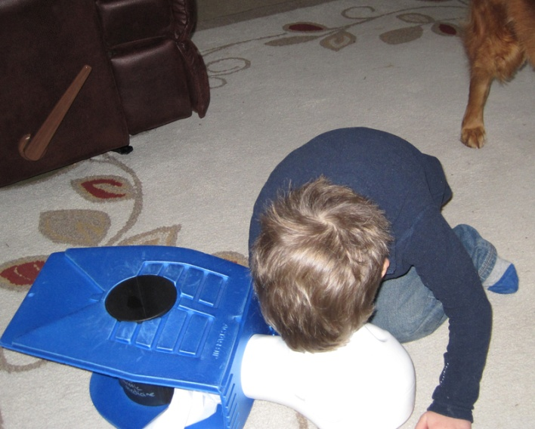
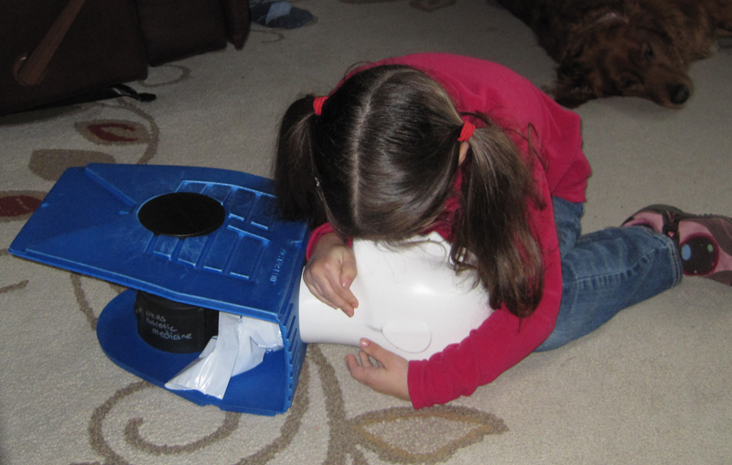
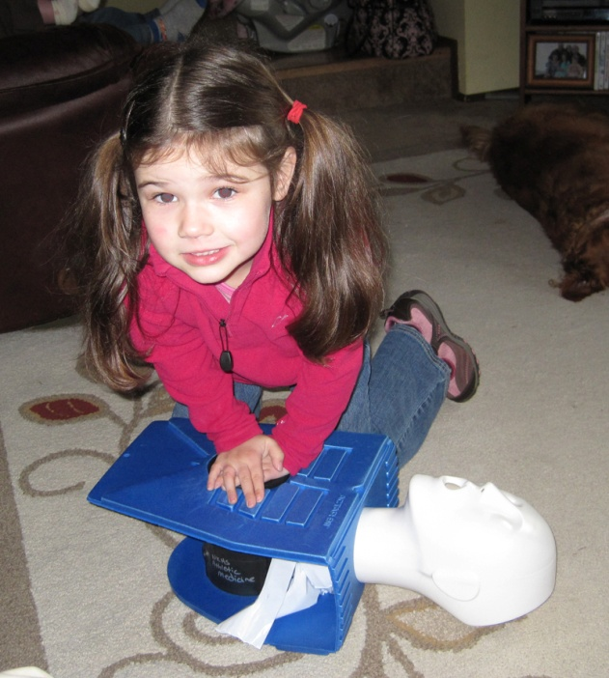
You are never too young to save a life.

Slide 29
Automated External Defibrillator (AED)
1. Size up the scene
2. Assess Responsiveness (Tap and shout)
3. Activate EMS and get AED
4. ABC
5. No breathing or signs of circulation perform CPR
6. AED arrives
7. Bare, prepare, and place pads
8. Begin analysis of heart rhythm
9. Clear patient
10. Deliver shock

Slide 30
Other Considerations for AED
What is the first step in using the AED???
Can you use it on a metal surface?
Can you use it in standing water?
How do you place it with someone who has a pacemaker/defibrillator/medication patch?
When do you turn on the AED if you didn’t see the patient collapse?

Slide 31
Other Considerations for AED
Environment
Implanted medical devises
Medication patches
Children
Emergency Oxygen

Slide 32
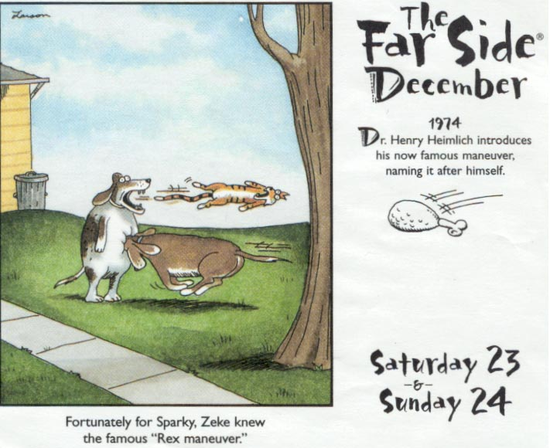
Choking

Slide 33
Choking- Responsive
Give medical statement
Ask them are you choking and can I help?
Encourage them to cough if they are able to cough
3. Give abdominal thrusts
Make a fist and put thumb side down just above the naval
Continue until airway is open or they go unconscious
What is different with a child/infant??

Slide 34
Choking Unconscious
Blocked airway
Start with 30 compressions
Look for object in mouth
Index finger for adult and child
Pinky finger for infant and small children
Head-tilt, chin-lift
2 breaths

Slide 35
Bleeding
Types of Bleeding
Arteriole Bleeding– Bleeding from an Artery
Bright red and spurting
Most serious
Two Arteries that you use to check a persons pulse:
Carotid Artery– Neck
Radial Artery– Wrist
Venous Bleeding– Bleeding from a Vein
Dark Red and continuous
Not as life threatening
Capillary Bleeding– Bleeding from the capillaries on the skin
Blood that oozes out.

Slide 36
Controlling Bleeding- PPE
Put on barriers.
Apply direct pressure- most effective
Do not remove bandages- even if they become soaked.
Place additional bandages over the soaked bandages
Elevate above heart.
May apply ice over bandages- shrinks blood vessels
Dispose of waste in biohazard bag or container.

Slide 37
Open Wounds
Abrasion– a Superficial wound caused by rubbing, scraping, or shearing in which a skin layer has been lost.
Uniqueness–
Extremely Painful– Nerve endings are damaged
Blood may ooze
Largest threat is contamination and/or infection
Tx–
Control bleeding
Clean out debris
Cover with sterile dressing

Slide 38
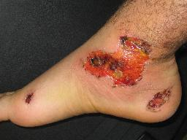
Abrasion

Slide 39
Open Wounds
Incisions– are sharp, even cuts with smooth edges that tend to bleed freely because the vessels and tissue have been severed.
Uniqueness–
Severe bleeding
Might damage tendons and Nerves
Tend to heal better than Lacerations
Tx–
Control Bleeding
Draw edges together
Tx for shock
Transport to physician

Slide 40
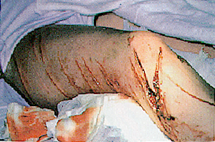
Incisions

Slide 41
Open Wounds
Laceration– A tear inflicted by a sharp, even instrument that produces a ragged incision through the skin surface and underlying tissues
Uniqueness–
Significant bleeding
Healing is very difficult
May contain foreign matter
Tx–
Control bleeding
Remove surface dirt and loose debris
Cover with sterile dressing
Elevate the injured part
Tx for shock
Transport to Hospital

Slide 42
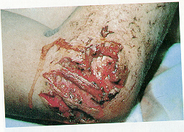
Laceration

Slide 43
Open Wounds
Puncture– is a wound caused by the penetration of a sharp object through the skin and underlying structures.
Uniqueness–
Even though the opening is small, puncture maybe deep
Serious threat of infection
Not a lot of bleeding unless it is in the chest
Always assess for an exit wound
Tx–
Let the wound bleed freely
Clean area around wound
Cover with sterile dressing
Transport to hospital

Slide 44
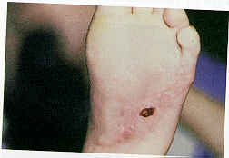
Puncture

Slide 45
Open Wounds
Avulsion Wound– the tearing loose of a flap of skin, which may either remain hanging or be torn off all together.
Uniqueness–
Scarring is often extensive
Bleeds profusely
Most common avulsed parts:
Fingers
Toes
Hands
Forearms
Feet
Ears
Nose

Slide 46
Avulsion Wound
Tx–
Clean the wound’s surface
Fold flap of skin back into normal position
Control Bleeding
Apply Dry, Bulky, Sterile dressing
Tx for Shock
Transport victim to Hospital
Transporting an Avulsed part
Rinse part in water
Wrap part in clean dry sterile gauze
Seal in plastic bag
Transport on Ice, not surrounded by ice.

Slide 47
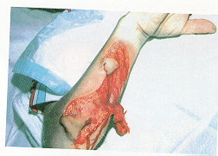
Avulsion Wound

Slide 48
Shock
Signs/symptoms
Become uneasy, restless, or worried
Pale blue gray tissue color
Moist, cool, and clammy skin
Shallow, rapid breathing
Rapid pulse
Thirst
Confusion
Nausea, vomiting
Treatment
Maintain body temperature
Elevate legs only if you don’t suspect neck/spine injury
Keep them calm
Monitor vitals

Slide 49
Types of Shock
Hypovolemic- trauma from severe blood loss. Without O2, organs cannot survive
Respiratory- trauma or injury occurs and the lungs are unable to supply O2 to the blood
Neurogenic- dilation of blood vessels. The 6 liters cannot fill the system
Psychogenic- fainting (syncope). A temporary dilation of blood vessels causing decrease blood to the brain
Cardiogenic- inability of the heart to pump enough blood
Septic- from a severe infection
Anaphylactic- severe allergic shock
Metabolic- when severe illness goes untreated or extreme loss of body fluid (vomiting, urination)

Slide 50
Diabetic
Type I “Juvenile-Onset” Diabetes– Diabetes that results when the body produces too little or no insulin
Take insulin injections to control diabetes
Type II “adult-onset”Diabetes– Diabetes that results when the body cannot utilize the insulin it produces
Controls Diabetes with diet, exercise, and sometimes pills and injections
Give sugar not insulin. If they don’t respond to treatment activate EMS

Slide 51
Diabetic Complications
Circulatory problems
Blindness
Central Nervous System problems
Kidney Dysfunction
Stomach problems

Slide 52
Diabetic Emergencies
Diabetic Coma– Also known as hyperglycemia– A condition that results from too little insulin and too much sugar
Insulin Shock– Also known as hypoglycemia– A condition that results from too much insulin and too little food

Slide 53
Diabetic Coma– High Blood Sugar
Signs and Symptoms:
Intense Thirst
Extreme loss of weight
Breath that smells sweet
Labored breathing
Fatigue
Frequent Urination
Nausea
Flushed, dry, warm skin
Weakness
Fever
Frequent severe and intense abdominal pain
Tx:
Open Airway
Monitor Vitals
Activate EMS
This has a gradual Onset over a period of days to weeks

Slide 54
Insulin Shock–Low Blood Sugar
Signs and Symptoms:
Combativeness
Headache
Speech Difficulties
Dizziness
Fatigue
Convulsion
Shakiness
Weakness
Pale, Moist skin
Profuse sweating
Behavioral Disturbances
Tx:
Give them Sugar
Rapid onset over a period of minutes
Can be deadly in a few minutes

Slide 55
Diabetic Emergencies
WHEN IN DOUBT, GIVE THEM SUGAR.
YOU MAY SAVE A LIFE OF A VICTIM IN INSULIN SHOCK BY GIVING THEM SUGAR

Slide 56
Head Injuries
Signs/symptoms
Headache
Nausea
Dizzy
Blurred vision
Unconscious
Not all there
Emotional state changed
Unequal pupils
Treatment
Monitor signs and symptoms.
Call parents.
Notify EMS if signs/symptoms get worse

Slide 57
Neck and Spine Injuries
**Unconscious victim-always suspect neck injury
Signs/symptoms
Numbness or tingling
Loss of function
Point tender over spine
Treatment
stabilize head and neck
call EMS
monitor vitals
Treat for shock

Slide 58
Abdominal Injury
Signs/symptoms
Swelling
Discoloration
Board like feeling
Shock
Mechanism of injury
Treatment
Treat for shock
Call EMS
Monitor vitals

Slide 59
Heat Illness
Heat exhaustion
Sweating
Pale color moist clammy skin
Rapid shallow breathing
Weakness
Dizzy
Headache
Treatment
Get to cool location
Remove restrictive clothing
Give fluids if they can drink
Monitor vitals very closely

Slide 60
Heat Illness Cont.
Heat stroke
Tissue color is red
Hot dry skin
Rapid pulse
Loss of consciousness
Disoriented and confused
Treatment
Cool immediately
Activate EMS
Monitor vitals

Slide 61
Allergic Reaction
Signs/symptoms
Skin flushed-hives
Shock
Breathing difficulty
Lower levels of responsiveness
Swelling eyes, face, tongue, throat
Respiratory arrest
Itching, burning
Nausea
Dizzy
Treatment
Activate EMS
Check for bee sting kit or Benadryl
Treat for shock

Slide 62
Heart Problems
Signs/Symptoms
Heart attack
Pale, blue tissue
Sweating
Denial
Pain not relieved by rest
Uncomfortable pressure
Pain radiates to shoulder, neck, jaw, or arms
Treatment
Activate EMS
Make them comfortable
Monitor vitals

Slide 63
Asthma
Signs/symptoms
Labored breathing
Wheezing sound when exhaling
High pitched cough
Weakness
Treatment
Assist with medication
Activate EMS if not getting better or no history of asthma
Calm them down
Get into a warm moist room
Monitor vitals

Slide 64
Epileptic Seizures
Signs/Symptoms
May suddenly stiffen and fall
Jerking movements
Jaw muscles tighten
Patient may stop breathing
May lose control of bladder
Become very tired afterward
Treatment
Allow to rest
Keep people away
Activate EMS if
Person is injured
Has no history of seizures
Does not resume breathing after seizures
Has continuous seizures
Seizures last more than ten min in a known seizure patient

Slide 65
Sprain vs. Strain
Sprain is an injury to a ligament
Ligament connects bone to bone.
Strain is an injury to a tendon or muscle
Tendon connects muscle to bone
A muscle is a special type of tissue that contracts, or shortens when stimulated. Responsible for all body movement.

Slide 66
Sprains
Signs/Symptoms:
Pain in movement
Tenderness
Swelling
Redness

Slide 67
Strains
Signs/Symptoms:
Immediate burning pain
Little Swelling
Little Discoloration
Might be some deformity

Slide 68
Treatment for Sprains, Strains, & Contusions
The RICE Method
Rest– Splint the injured part to give it complete rest
Ice– Put ice packs, crushed ice, or cold towels on the injured area for 15 to 20 minutes.
Compression– Use a compression bandage to limit swelling.
Elevation– Elevate the injured area above heart level.
This should be followed for 48-72 hours after the injury

Slide 69
Fracture vs. Dislocation
Fracture– is a break in the continuity of a bone. (AKA Broken Bone)
Two Types of Fractures
Open Fracture– The bone breaks through the skin (AKA Compound Fracture)
Closed Fracture- The overlying skin has not been broken
Dislocations– is a displacement or separation of a bone from it’s normal position at a joint.
Subluxation– when a joint partially dislocates.
Dislocations and Subluxations may relocate on their own.

Slide 70
Fractures
Signs/Symptoms:
Pain
Point tenderness
Loss of use
Swelling
Bruising
Crepitus
Possible Bone exposure
Possible Deformity

Slide 71
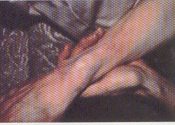
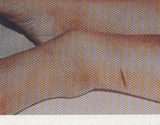
Closed Fractures

Slide 72
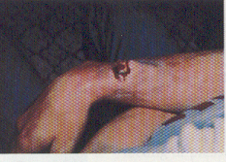
Open Fractures

Slide 73
Dislocations
Signs/Symptoms:
Pain
Deformity
Loss of movement
Tx:
Splint above and below the dislocated joint
Treat for Shock
Place an ice pack on it.
*DO NOT TRY TO REDUCE (STRAIGHTEN) THE DISLOCATION

Slide 74
Dislocations

Slide 75
Splinting
1. Splint as you find it
2. Circulation in fingers and toes
3. Splint one joint above and one joint below to stabilize the injured area

Slide 76
Emergency Cards
Everyone needs one on file with the coach or athletic trainer
They must travel with the athletes
They are given to EMS for contact numbers and medical warnings
Hospital preference

Slide 77
Documentation
Injury documentation must be done.
Date and time of injury
First aid given
Who was notified of the injury
Location of the injury
Treatment documentation:
Date
What was done and progress of injury status

