Slide 1
Fractures
And the general healing process

Slide 2
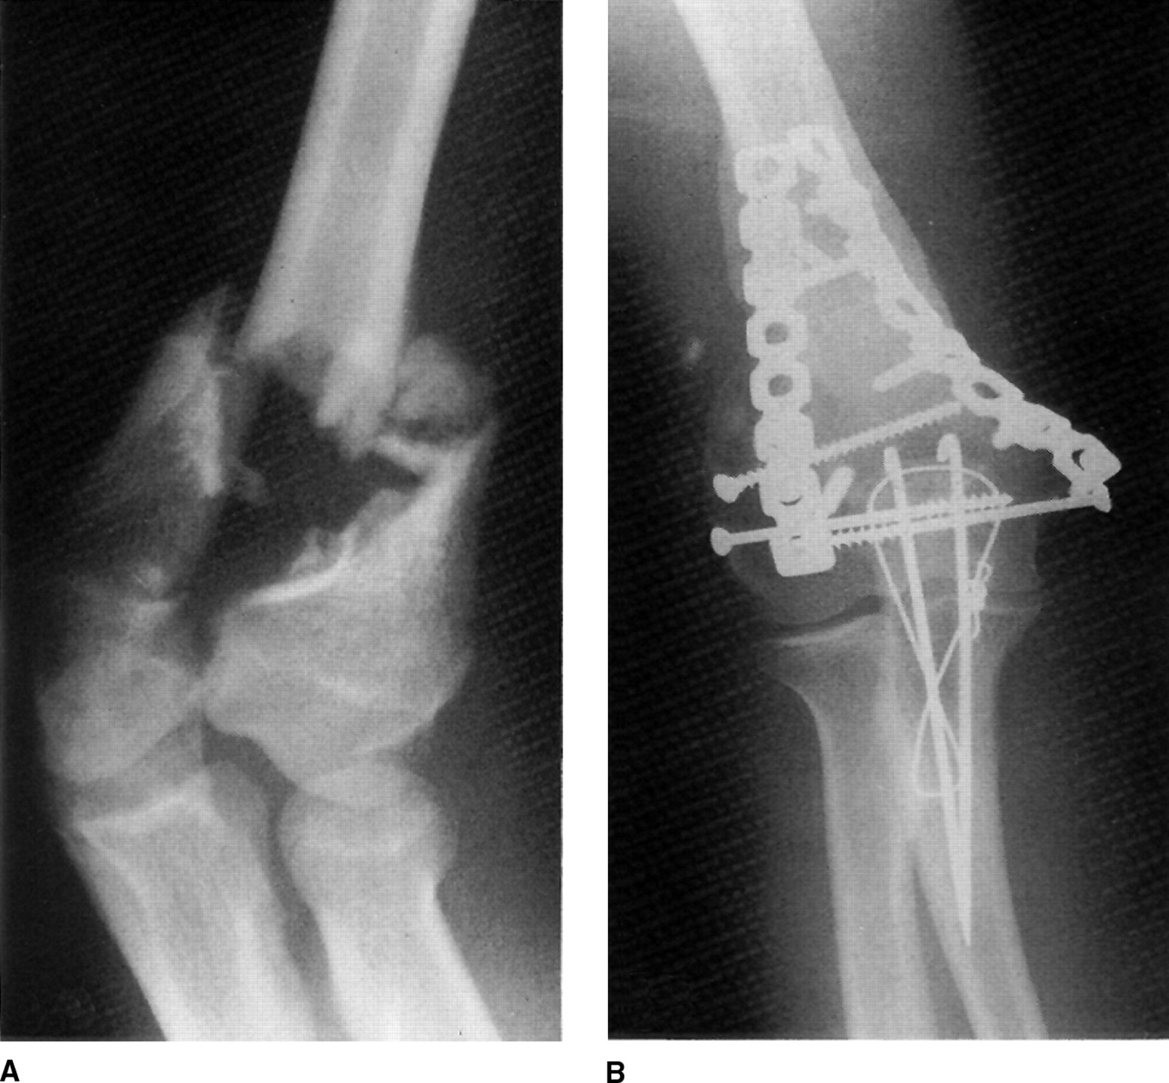

Slide 3
Bone Growth
Osteoblasts- Bone cells that deposit new bone
Osteoclasts- Bone cells that reabsorb bony tissue
Bones continue to grow in length until the epiphyseal cartilage is ossified
Females- 18 years
Males- 20-21 years
Fractures activate new bone cells

Slide 4
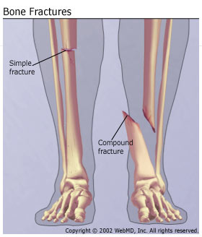
Classifications
Classified by degree of injury to the bone
Closed or Simple- Does not break through the skin. Can be complete or incomplete
Open or Compound- Fracture comes through the skin

Slide 5
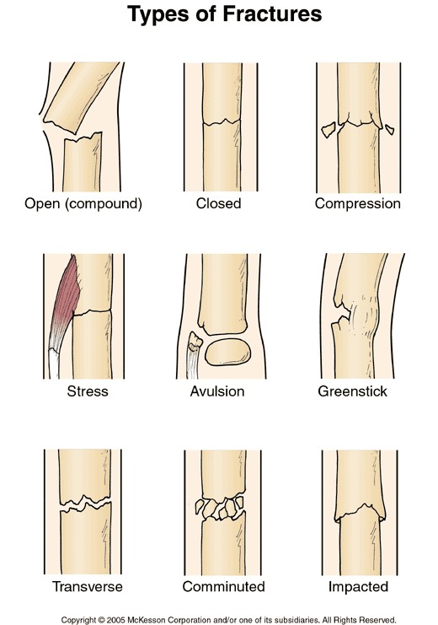
Greenstick- Most common in children and adolescents because the bone is more pliable. Breaks only the outer part of the bend
Comminuted- The force to the bone is so great it shatters into 3 or more pieces. Usually from a hard blow or falling in an awkward position
Impacted- Where the tissues are compressed; bone on bone. Usually from a direct fall or impact to the long axis of the bone

Slide 6
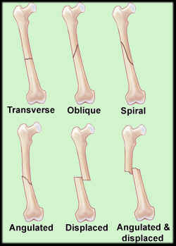
Transverse- Breaks in a straight line, more or less at a right angle to the shaft of the bone. Usually from a direct outside blow
Oblique- Similar to spiral fractures but is when on e end receives sudden twisting while the other end is fixed
Spiral- Have an S-shaped separation. Common in football and skiing where the foot is planted and body suddenly rotates in the opposite direction

Slide 7
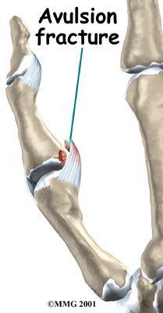
Linear- Breaks that where the bone splits along its length. Often from jumping and landing oddly.
Avulsion- Often from the separation of bone at the attachment of a ligament or tendon. Usually occurs with powerful, quick twisting motions
Blowout- A fracture to wall of the eye orbit
Contrecoup- Fractures that occur on the opposite side of the trauma. Usually in the skull
Serrated- where two bony fragments create sawtooth edges putting organs at risk
Depressed- most often in flat bones like the skull.

Slide 8
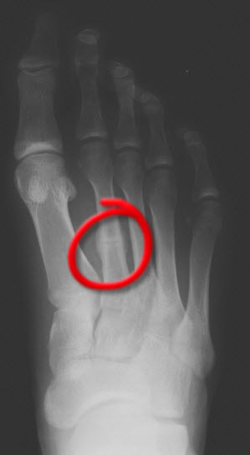
Stress Fractures
Has been called: March, fatigue, and spontaneous
Caused by:
Overload by muscle contraction
Altered stress distribution with muscle fatigue
Change in ground reaction force
Rhythmic repetitive stress
Overtraining
Most often in :
Tibia
Fibula
Metatarsal shaft
Calcaneus
Femur
Pars interarticularis of the lumbar vertebrae
Ribs
Humerus

Slide 9
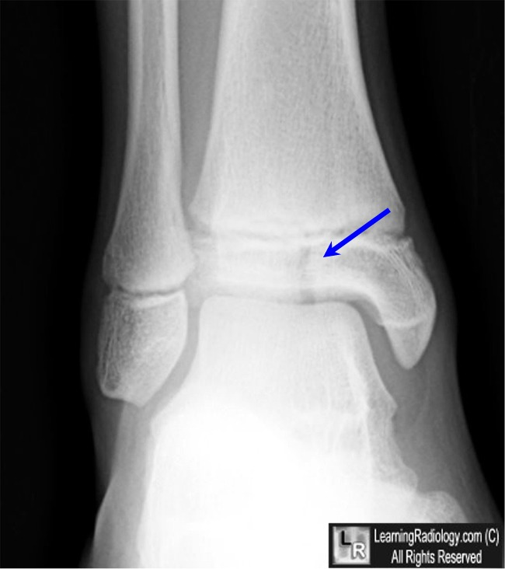
Epiphyseal Fractures
Only accounts for 10% of all fractures in children
Most common in wrist and ankle
75% occur in 10-16 year olds playing sports
The ligaments and capsular structures are 2-5x stronger than the most vulnearble part of the growth plate

Slide 11
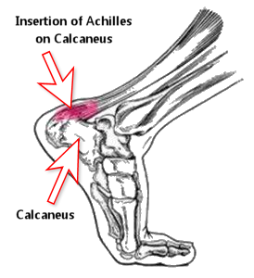
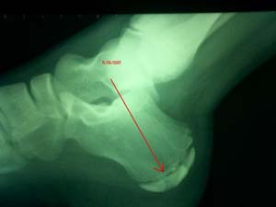
Apophyseal Injuries
The apophyses serve as insertion for muscles on growing bones that provide shape but not length. Traction epiphyses.

Slide 12
Wolff’s Law
Bone and soft tissue will respond to the physical demands placed on them, causing them to remodel or realign along lines of tensile force

