Slide 1
The Muscular System

Slide 2
Definition of Muscular System
“The muscular system is an organ system consisting of skeletal, smooth and cardiac muscles. It permits movement of the body, maintains posture, and circulates blood throughout the body.”
http://en.wikipedia.org/wiki/Muscular_system

Slide 3
Definition of Musculoskeletal System
“all the muscles, bones, joints, and related structures, such as the tendons and connective tissue, that function in the stability and movement of the parts and organs of the body.”
http://medical-dictionary.thefreedictionary.com/musculoskeletal+system

Slide 4
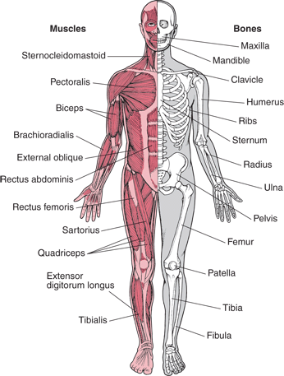
A skeletal muscle is attached to one bone at one end, and across a joint, to another bone at it’s other end
When a muscle contracts, one bone is pulled toward the other
During contraction, a muscle becomes thicker and shortens by about 15%
A contracted muscle is brought back to it’s resting position by the contraction of it’s opposing muscle

Slide 5
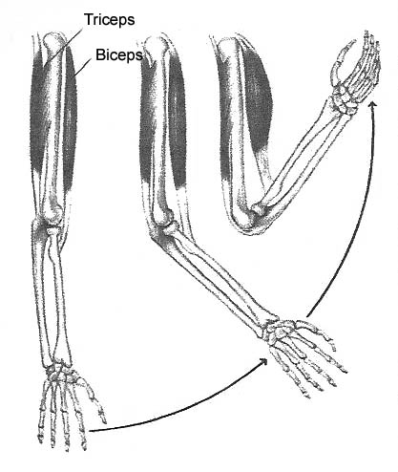
Every movement caused by skeletal muscle involves at least two sets of muscles
Most muscles can be stretched to about 120 percent of it’s resting length

Slide 6
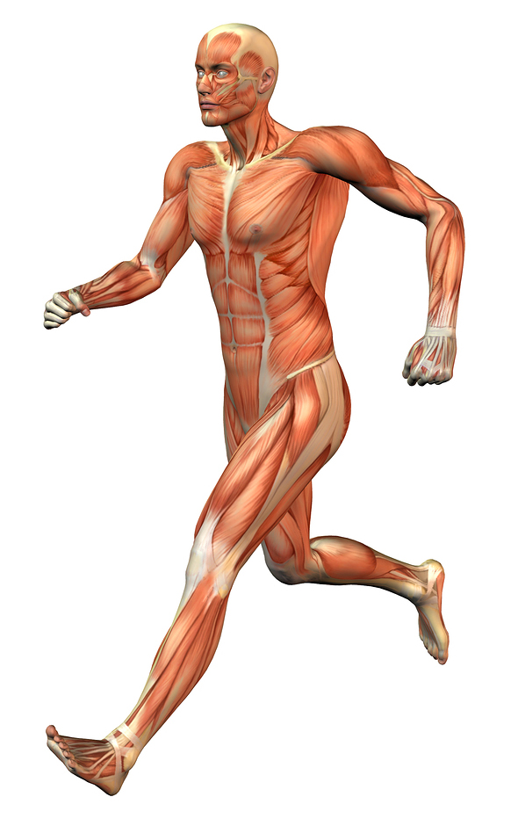
There are 640 muscles in the body
Roughly 320 pairs of muscles
There are 3 types of muscles
Skeletal
Smooth
Cardiac

Slide 7
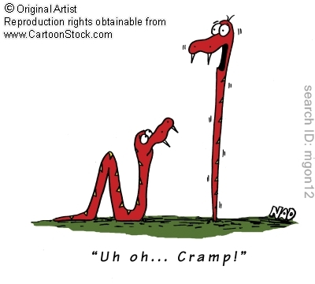
Skeletal Muscle
Voluntary muscle
Attached to bones
Striped or striated: light and dark bands in muscle. Nuclei are along edges of fibers
Movement to limbs
Contracts quickly
Fatigues easily
Unable to remain contracted for any length of time

Slide 8
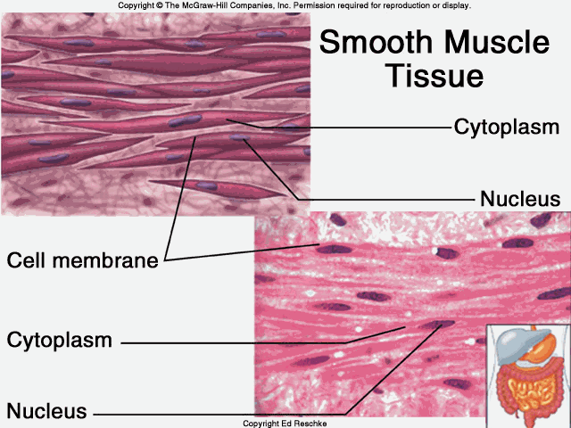
Smooth Muscle
Not voluntary
Visceral- internal organs
Small, spindle shaped muscles with no striations
Does not attach to bones
Contracts slowly
Fatigues slowly
Able to remain contracted for long periods of time

Slide 9
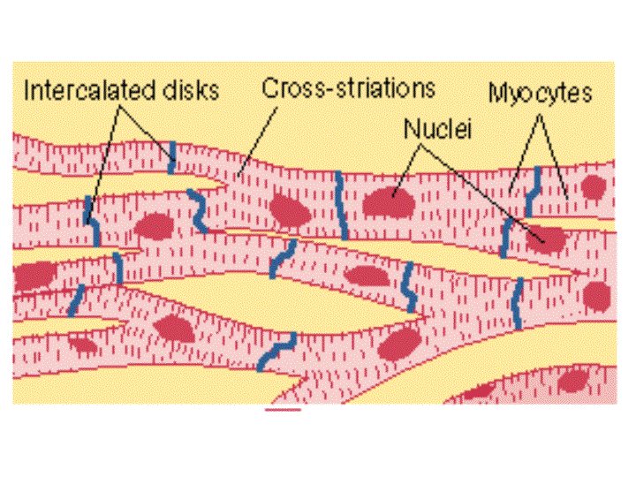
Cardiac Muscle
Only in the heart
Short, striated and branched with a centrally located nucleus
Involuntary
Continuous network-able to contract at the same time
If O2 is cut-off for even 30” cardiac muscle cells start to die off

Slide 10
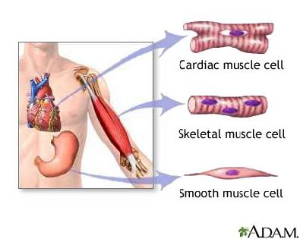

Slide 11
Characteristics of Muscle
Contractibility
Excitability
Extensibility
Elasticity

Slide 12
Contractibility- the ability to shorten or reduce the distance between parts
Excitability- The ability to respond to stimuli
Extensibility- the ability to lengthen and increase the distance between two parts
Elasticity- The ability to return to original form after being compressed or stretched

Slide 13
All muscles contain:
A fleshy center, often the widest part, known as a belly.
Two ends that attach to other tissues
Muscles connect to bone by one main tissue
Tendons
Sometimes the tendon spreads out to form an apponeurosis

Slide 14
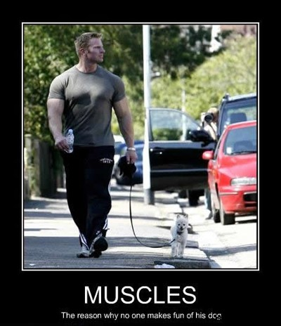
The name of a muscle generally tells something about its structure, location, or function.
They are name for the following:
Shape
Attachment sites
Number of heads of origin
Action
Direction of Fibers
Most muscles are named by a combination of methods

Slide 15
Medical Terminology
Origin- The part of the skeletal muscle that is attached to the fixed part of a bone
Insertion- The part of the skeletal muscle that is attached to the moveable part of a bone
Belly- The central part of a muscle
Prime Mover- Muscle that provides movement in a single direction
Antagonist- A muscle whose action opposes the action of another muscle
Agonist- The muscle doing the work
Synergist- Muscle that help steady a joint

Slide 16
LEVERS
Skeletal muscles employ simple machines to increase the efficiency of their work at a joint.
The movements of most skeletal muscles are accomplished through a systems of levers.
Components of the system
Lever Arm— the arm used to move something
Fulcrum– fixed point (the joint being used)
Force

Slide 17
1st Class Levers
In a 1st class lever,
The force is applied at one end of the lever arm,
the weight to be moved is at the other end and,
the fulcrum (joint) is at a point between the two.
An example is trying to lift a box with a crowbar
In the body, looking up to the sky.
The Neck joint acts as the fulcrum
The Trapezius muscle (in the back of the neck) act as the applied force
The face is the weight to be moved

Slide 18
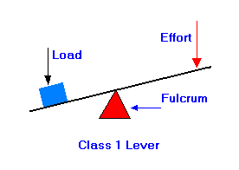
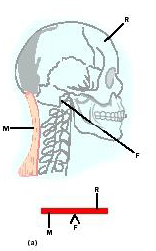
1st Class Levers

Slide 19
2nd Class Levers
In a 2nd class lever,
The force is applied at one end of the lever arm,
The fulcrum (joint) is at the other end of the lever arm.
The weight to be moved is in the middle
An example is a Wheelbarrow
In the body, Standing on your “tip-toes”
The ball of the foot acts as the fulcrum
The calf muscle act as the applied force
The body weight is the weight to be moved

Slide 20
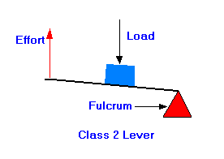
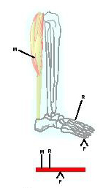
2nd Class Levers

Slide 21
3rd Class Levers
In a 3rd class lever,
The weight to be moved is at one end of the lever arm,
The fulcrum (joint) is at the other end
The applied force is close to the fulcrum.
An example is lifting a shovel of dirt
In the body, flexing the forearm at the elbow joint to lift a weight.
The elbow joint acts as the fulcrum
The Biceps muscle contracting acts as the applied force
The weight in the hands and weight of the forearm is the weight

Slide 22
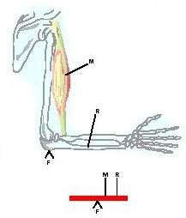
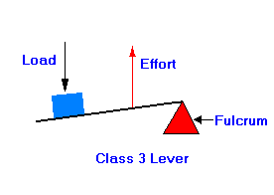
3rd Class Levers
A 3rd class lever is the most common lever of the body.

Slide 23
Leverage: Mechanical Advantage
If you have ever used a screwdriver to pry open a can of paint, you know that the screwdriver (Lever) made the work easier.
The leverage of a muscle is improved as the distance from the insertion to the joint (fulcrum) is increased.
A muscle with an insertion relatively far from a joint has more power than a muscle with an insertion closer to the joint
Reason: the longer lever arm between the joint and insertion produces more power.
Think of a baseball pitcher

Slide 24
Muscle Strains
“Muscle strain -- or muscle pull or even a muscle tear -- implies damage to a muscle or its attaching tendons.”
-Webmd.com

Slide 25
Signs and Symptoms
Swelling, bruising or redness, or open cuts due to the injury
Pain at rest
Pain when the specific muscle or the joint in relation to that muscle is used
Weakness of the muscle or tendons
Inability to use the muscle at all

Slide 26
Sprains
“A sprain is a stretch or tear in a ligament (the bands of fibrous tissue that connect our bones at the joints).”
- Webmd.com

Slide 27
Signs and Symptoms
Pain
Swelling
Bruising
Limited ability to move the affected joint
At the time of injury, you may hear or feel a "pop" in your joint

Slide 28
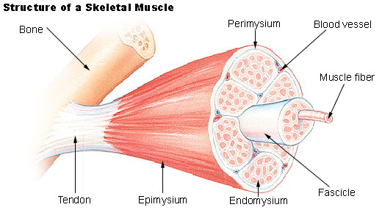
A Muscle Fiber

Slide 29
Epimysium- The outermost layer, surrounding the whole muscle
Perimysium- Surrounds bundles of fascicles
Fascicles- Surrounds bundles of muscle fibers
Endomysium- Separating each muscle fiber
Muscle fiber- a cylindrical, multinucleate cell composed of numerous myofibrils that contracts when stimulated
Myofibril- a filament of contractile protein within a muscle cell.
The epimysium, perimysium, and endomysium are all continuous and contribute to the connective tissue that attaches muscle to other structures.

Slide 30
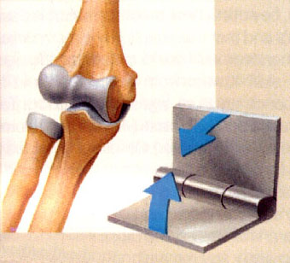
Joints
The articulation of two bones
Fibrous (a), Cartilaginous (b), or Synovial (c)

Slide 31
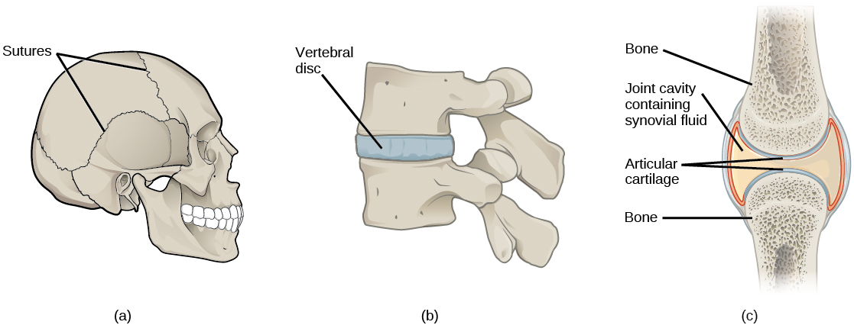
Joints
Fibrous & Cartilaginous joints have little to no movement
Synovial joints allow for different movements

Slide 32
Synovial Joints
6 Types
Ball and Socket Joint: movement in every plane. Hip joint
Ellipsoid Joint: flexion/extension and abduction/adduction. Metacarpals
Hinge Joint: flexion/extension. Knee joint
Saddle Joint: a freely moveable joint. Thumb joint
Gliding Joint: Movement side-to-side or back-and-forth. Carpals
Pivot Joint: Freely moveable joint. The ulna and radius

Slide 33
Muscle Shapes
Parallel or Flat
Fusiform
Circular
Triangular or Convergent
Pennate

Slide 34
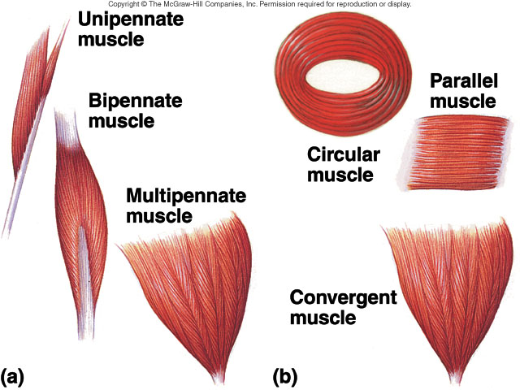

Slide 35
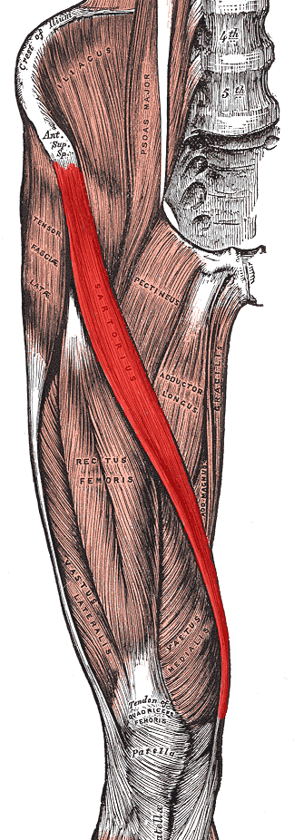
Parallel or Flat
End at either end in flat tendons
Parallel to longitudinal axis

Slide 36
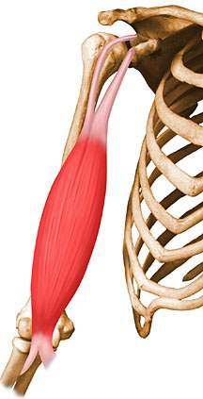
Fusiform
Nearly parallel to longitudinal axis of muscle
Ends in flat tendons
Muscle tapers toward tendon
Belly wider than tendon

Slide 37
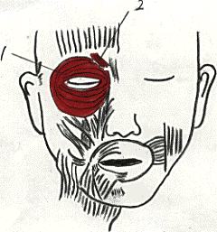
Circular
The fascicles form in circular arrangements that enclose an opening

Slide 38
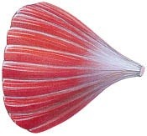
Triangular or Convergent
Spread over a broad area and come together at a central tendon
Tendon is very thick
Gives the muscle a triangular look

Slide 39
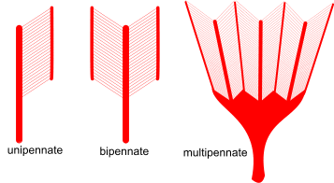
Pennate
Short fasicles in relation to total length
Tendon extends nearly entire length of muscle
Unipennate
Bipennate
Multipennate

Slide 40
Unipennate
Arranged only to one side of tendon

Slide 41
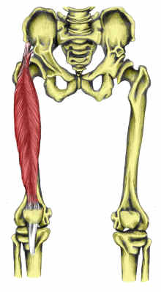
Bipennate
Arranged on both sides of the tendon
Tendon is centrally positioned

Slide 42
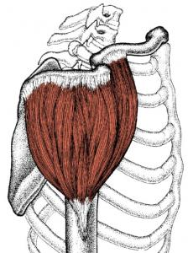
Multipennate
Attach at an angle from many different directions to several tendons

Slide 43
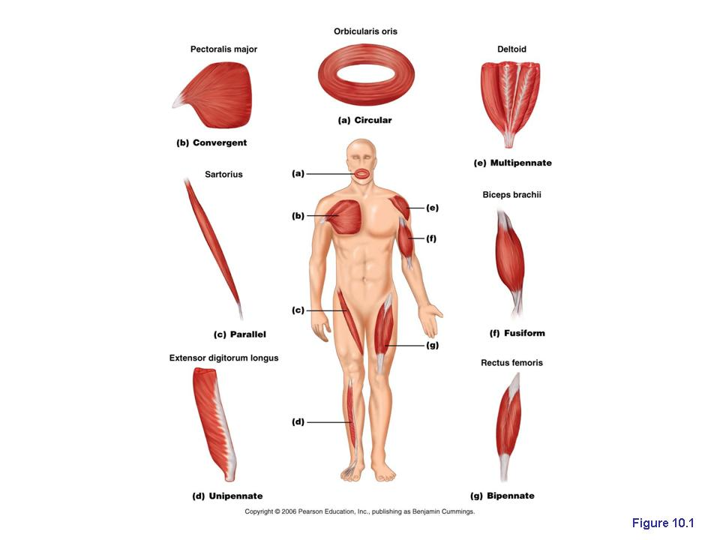

Slide 44
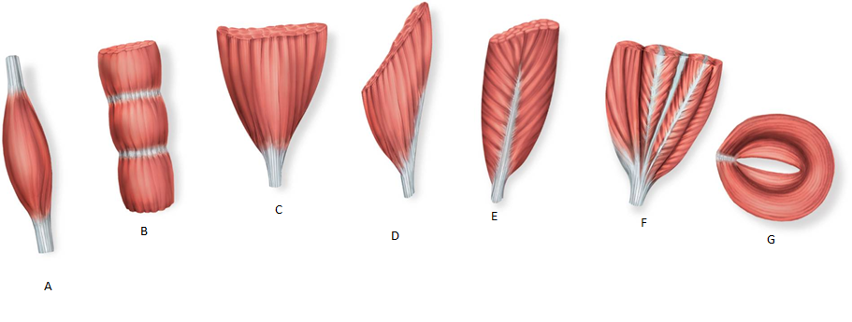

Slide 45
Muscles

Slide 46
Terminology
Characterstics Used to Name Muscles
Direction: Orientation relative to body’s midline
Rectus- Parallel to midline. Ex. Rectus abdominis
Transverse- Perpendicular to midline. Ex. Transverse abdominis
Oblique- Diagonal to midline. Ex. External oblique

Slide 47
Size: Relative size of muscle
Maximus- Largest ex. Gluteus maximus
Minimus- Smallest ex. Gluteus minimus
Longus- Longest ex. Adductor longus
Brevis- Shortest ex. Peroneus brevis
Latissimus- Widest ex. Latissimus dorsi
Magnus- Large ex. Adductor magnus
Major- Larger ex. Pectoralis major
Minor- Smaller ex. Pectoralis minor
Vastus- Great ex. Vastus lateralis

Slide 48
Shape: Relative shape of muscle
Deltoid- Triangular ex. Deltoid
Trapezius- Trapezoid ex. Trapezius
Serratus- saw-toothed ex. Serratus anterior
Rhomboideus- diamond shaped ex. Rhomboideus major
Pectinate- comblike ex. Pectineus
Piriformis- pear-shaped ex. Piriformis
Quadratus- square ex. Quadratus femorus
Gracilis- slender ex. Gracilis

Slide 49
Action: Principal action of the muscle
Flexor- decrease joint angle ex. Flexor digitorum longus
Extensor- increases joint angle ex. Extensor digitorum longus
Abductor- moves bone away from midline ex. Abductor pollicis longus
Adductor- moves bone closer to midline ex. Adductor longus
Levator- produces superior movement ex. Levator scapulae
Supinator- turns palm superiorly or anteriorly ex. Supinator
Pronator- turns palm inferiorly or posteriorly ex. Pronator teres
Tensor- makes a body part rigid ex. Tensor fascia latae
Rotator- moves bone around a longitudinal axis ex. Obturator externus

Slide 50
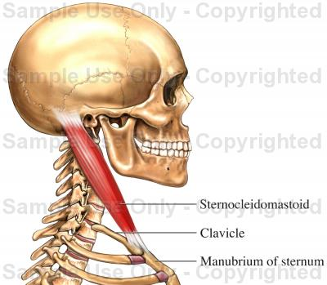
Muscles of the Neck
Sternocleidomastoid-
From back of head head to sternum
Tilts head from side to side and flexes neck

Slide 51
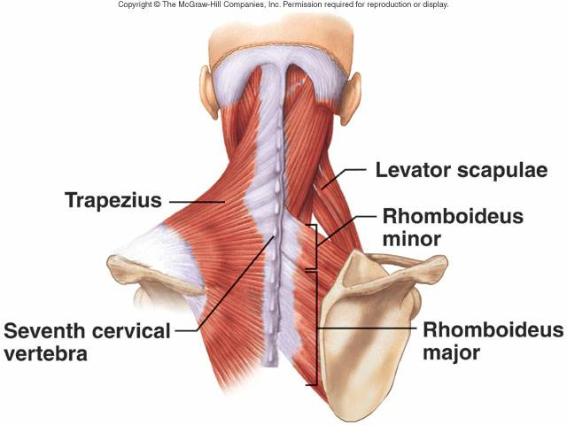
Back Muscles
Trapezius- Elevates, retracts, depresses, and rotates the scapula.
Latissimus dorsi- Extends, adducts, and medially rotates humerus
Levator scapulae- Elevates scapula
Rhomboid minor and major- Adduct scapula

Slide 52
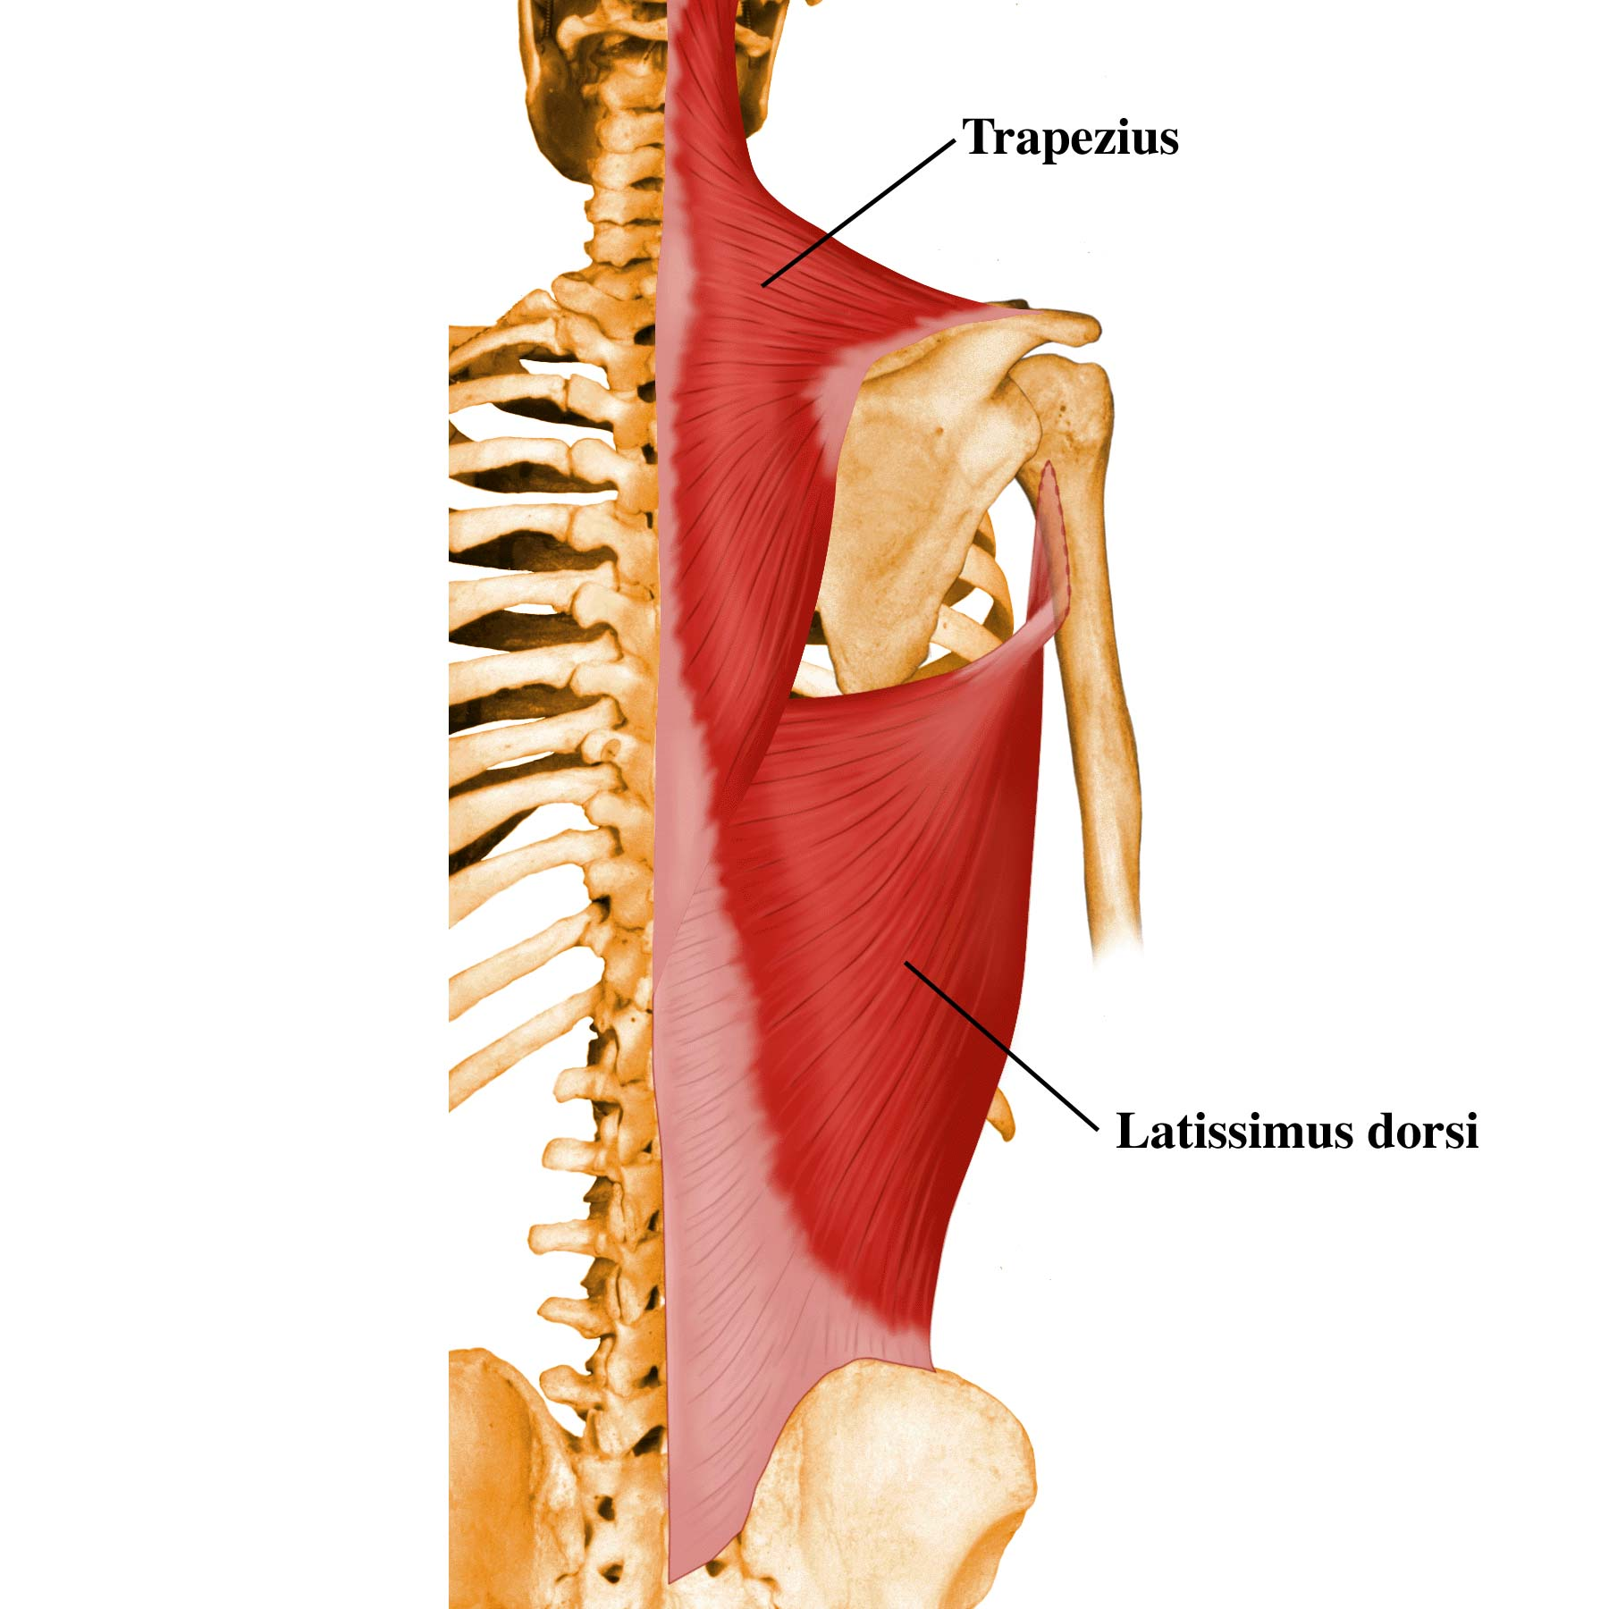

Slide 53
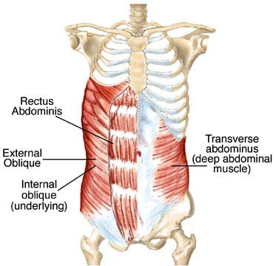
Anterior Abdominal Wall Muscles
External oblique- flexes and rotates trunk
Internal oblique- flexes and rotates trunk
Transverse abdominis- Compresses and supports abdominal viscera
Rectus abdominis- flexes trunk and compresses abdominal viscera

Slide 54
Posterior Shoulder Muscles
Trapezius- 3 parts
- Superior fibers- elevate scapula
- Middle fibers- adducts scapula
- Inferior fibers- depress scapula
Latissimus dorsi- extends, adducts, and medially rotates humerus at shoulder
Levator scapulae- elevates scapula
Rhomboid major and minor- adducts scapula
Teres major- extends arm and internally rotates shoulder

Slide 55
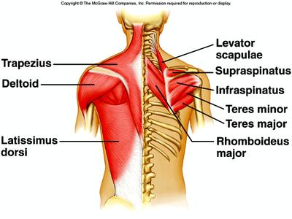
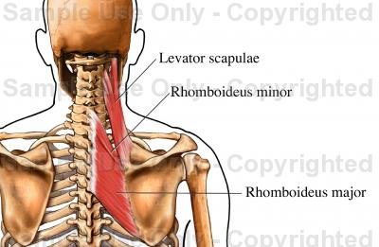

Slide 56
Rotator Cuff Muscles (SITS)
Supraspinatus- helps deltoid abduct arm at shoulder and works with the other rotator cuff muscles
Infraspinatus- externally rotates arm at shoulder
Teres minor- externally rotates arm at shoulder
Subscapularis- internally rotates arm at shoulder
** All stabilize the humerus in the glenohumeral joint

Slide 57
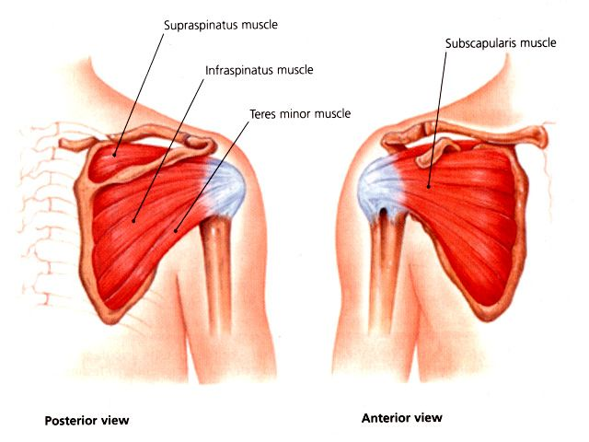

Slide 58
Anterior Shoulder Muscles
Pectoralis major- flexes, adducts, and internally rotates arm at shoulder; extension of flexed arm
Pectoralis minor- depresses scapula and stablizes it
Serratus anterior- Rotates scapula upward and pulls it anterior toward thoracic wall
Deltoid- 3 parts
- Anterior: flexes and internally rotates arm at shoulder
- Middle: abducts arm at shoulder
- Posterior: extends and externally rotates arm at shoulder

Slide 59
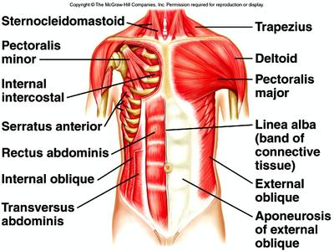
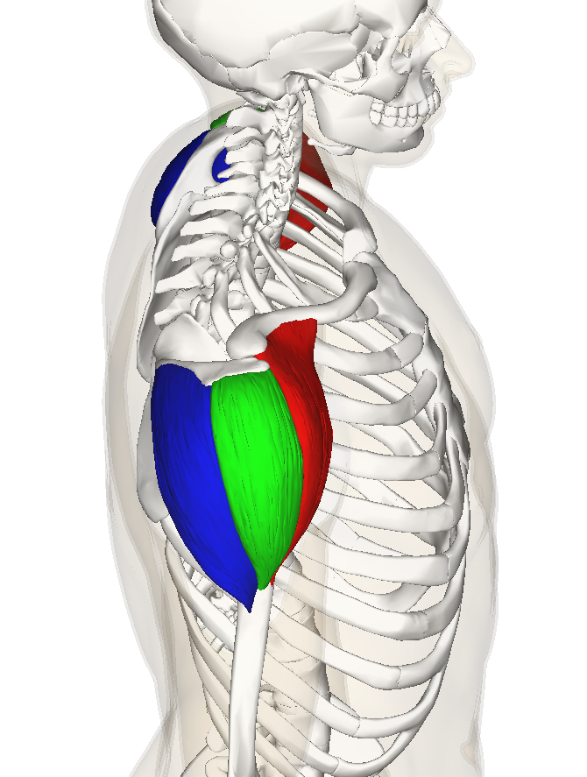

Slide 60
Arm Muscles
Biceps brachii- supinates flexed forearm; flexes forearm at elbow; weak arm flexor
Brachialis- flexes forearm at elbow in all positions
Coracobrachialis- helps flex and adduct arm at shoulder
Triceps brachii- extends forearm at elbow; primary extensor of elbow

Slide 61
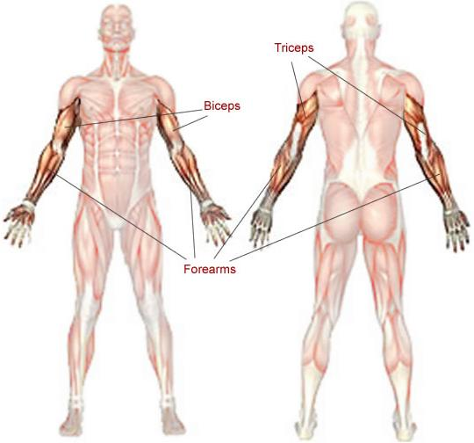
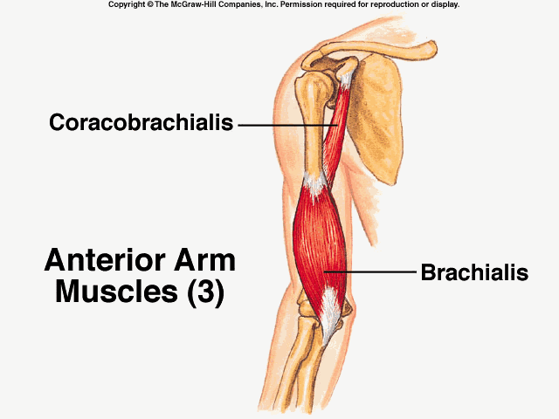
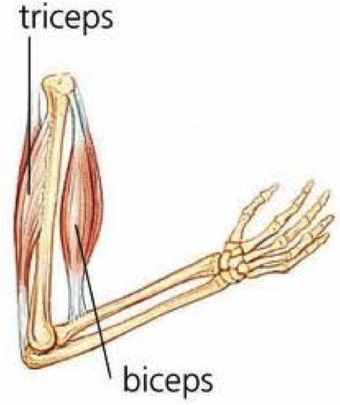

Slide 62
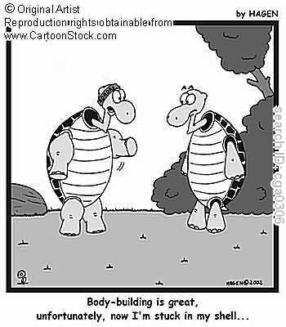

Slide 63
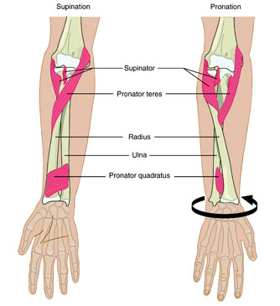
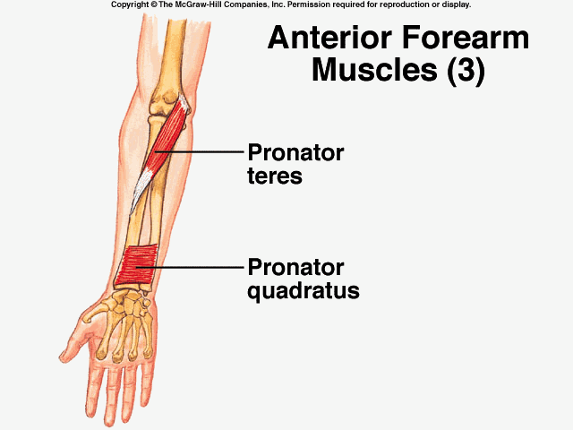
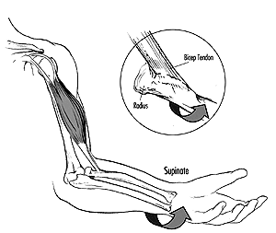
Pronators and Supinators
Pronators:
1) Pronator teres- is more superficial and close the elbow
2) Pronator quadratus- deep and near the wrist
Supinators:
1) the Biceps brachaii with the elbow flexed
2) the Supinator with the forearm straight

Slide 64
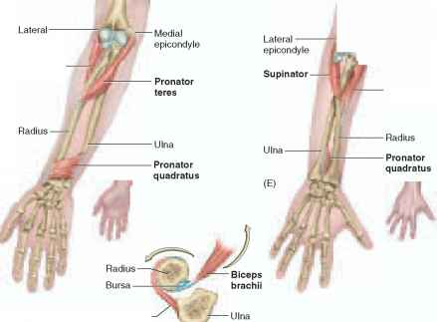
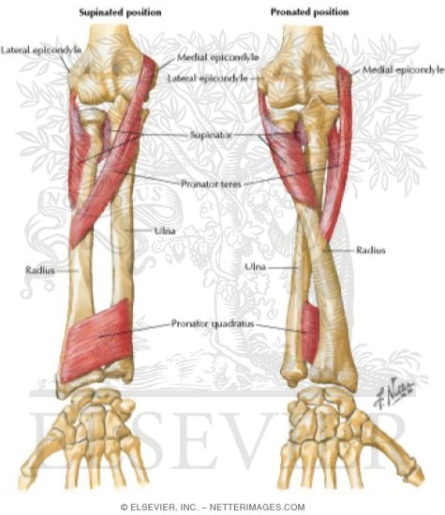

Slide 65
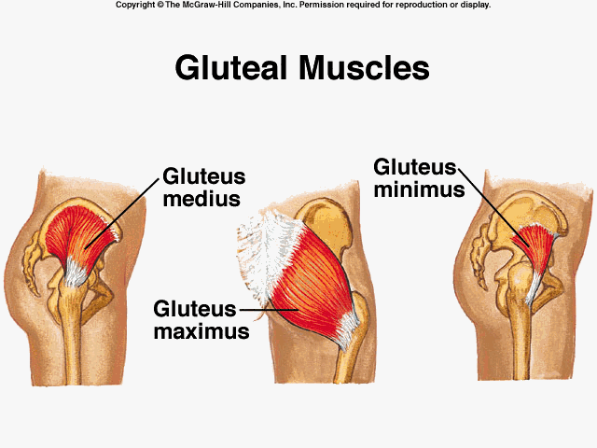
Gluteal Muscles
Gluteus maximus- Extends thigh and assists with ER
Gluteus medius- abducts and medially rotates thigh. Steadies pelvis when opposite leg is raised.
Gluteus minimus- abducts and medially rotates thigh. Steadies pelvis when opposite leg is raised.

Slide 66
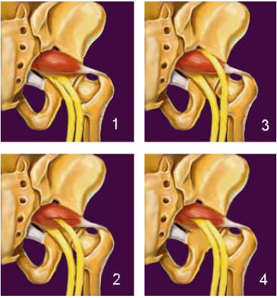
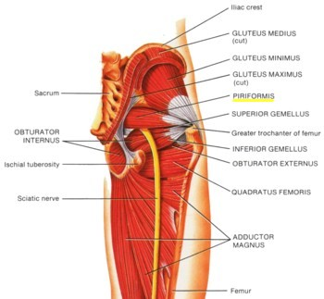
Piriformis
ER rotates thigh at hip and abducts flexed hip at thigh
Can compress the Sciatic nerve

Slide 67
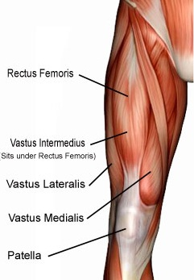
Anterior Thigh
Quadriceps
Rectus femoris- performs knee extension and hip flexion
Vastus medialis- performs knee extension
Vastus intermedius- performs knee extension
Vastus lateralis- performs knee extension

Slide 68
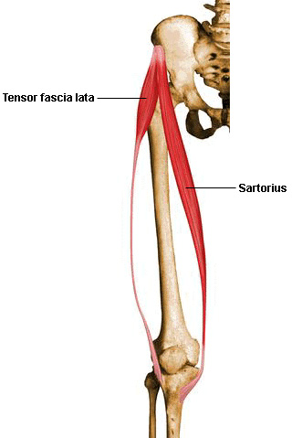
Sartorius & Tensor Fascia lata (TFL)
Part of the anterior thigh
The Sartorius is longest muscle in the body
Performs knee flexion; hip flexion, abduction, and ER
The TFL abducts, IR and flexes hip.
Helps keep the knee extended

Slide 69
Posterior Thigh
Biceps femoris- performs knee flexion and hip extesion. Performs ER of knee.
Semitendinosus- performs knee flexion and hip extension. IR flexed knee
Semimembranosus- performs knee flexion and hip extension. IR flexed knee

Slide 70
Medial Thigh
Adductors
Adductor magnus- Adducts and flexes hip. Extended thigh
Adductor longus-Adducts and IR thigh
Adductor brevis-Adducts thigh
Gracilis-Adducts thigh, flexes and IR knee
Pectineus-Adducts and flexes thigh. Assists with hip IR

Slide 71
Lateral Thigh
The Iliotibial Band (ITB) is the fascia that runs the lateral aspect of the leg.
It is the main dynamic stabilizer for the lateral thigh

Slide 72
Anterior Lower Leg
Tibialis anterior-Dorsiflexion and inversion of foot at ankle
Extensor digitorum longus- dorsiflexion of foot and extends 2-5th toes

Slide 73
Posterior Lower Leg
Gastrocnemius- Plantarflexion and knee flexion
Soleus- Plantarflexion
Achilles tendon- Largest tendon in the body

Slide 74
Lateral Lower Leg
Peroneal (Fibularis) longus- Eversion of foot and weak plantarflexor
Peroneal (Fibularis) brevis-Eversion of foot and weak plantarflexor
Peroneal (Fibularis) tertius-Dorsiflexion of foot and aids in eversion

